Slide 1
Does a Previous Corona Virus Epidemic Exposure in a Population Give Any Type of Immunity?
By: Julian Romero

Slide 2
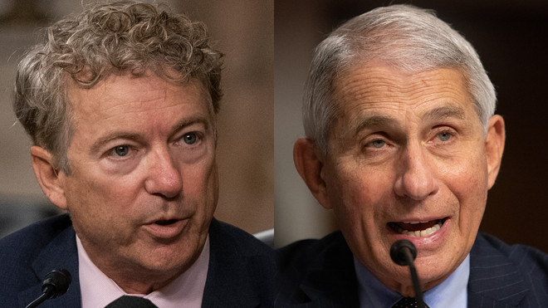
Why ask the question?
Recently Senator Rand Paul made a statement during a senate meeting where he tried to argue with Dr. Anthony Fauci if man can mitigate pandemics at all. In one of his arguments he states that people are trying to make a false correlation to stricter lockdowns with fewer corona virus deaths and cases as this was apparent with most Asian countries. He gives an alternative reason to this by stating:
“The population’s in Asian countries may have a higher degree of exposure to previous corona virus colds and therefore have more preexisting immunity.” – Rand Paul
https://www.youtube.com/watch?v=Yk2p2oyXxTc&ab_channel=CNN

Slide 3
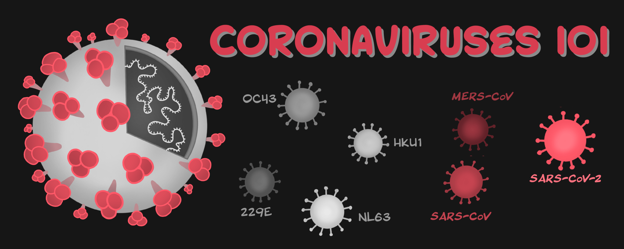
What is Rand Paul Talking About?
Before the existence of the pandemic of COVID-19. There was a previous corona virus epidemic in 2002-2004 from SARS. This epidemic effected mostly china and parts of Asia. In respect to corona viruses, there are so far three types of corona viruses that give diseases in humans. MERS was never an epidemic so with our study we will concentrate on SARS and compare it to COVID. Let us see if this is true or not.

Slide 4
Number of Cases for Previous Epidemic and Non-Epidemic Countries
Results seem to find that Epidemic countries have less cases than non epidemic countries

Slide 5
Number of Deaths for Previous Epidemic and Non-Epidemic Countries
Results seem to find that Epidemic countries have less deaths than non epidemic countries

Slide 6
Total Number per Million of Epidemic and non-Epidemic countries for Cases and Death
Results seem to find that Epidemic countries have less cases and deaths than non epidemic countries worldwide

Slide 7
Conclusion
It seems from the results that Ron Paul could be on to something, or that he is only looking at data that does not paint the whole picture. For all graphs it can seem that this could be an actual scenario where previous epidemic corona exposure could lead to higher resilience. However, the data itself most likely could have been effected by other factors such as stringency of lockdowns, cardiovascular death rate, diabetes prevalence, etc. This does raise another point that maybe these populations are more conscious of corona virus diseases due to having an epidemic before and adhere to proven safety guidelines like wearing masks, and social distancing.
Also the fact that there are so little cases, deaths, number of countries that had a corona virus epidemic can skew the data. More ways of testing this theory would be to test for antibodies that were given from previous corona virus epidemic and see if those patients survive. Perhaps future students can prove this if a new corona virus pandemic comes as they would have endless amount of data to compare it to for a good database project.

Slide 8
References
SARS dataset:
https://www.who.int/csr/sars/country/en/
Rand Paul Statement:
https://www.youtube.com/watch?v=Yk2p2oyXxTc&ab_channel=CNN

